Slide 1
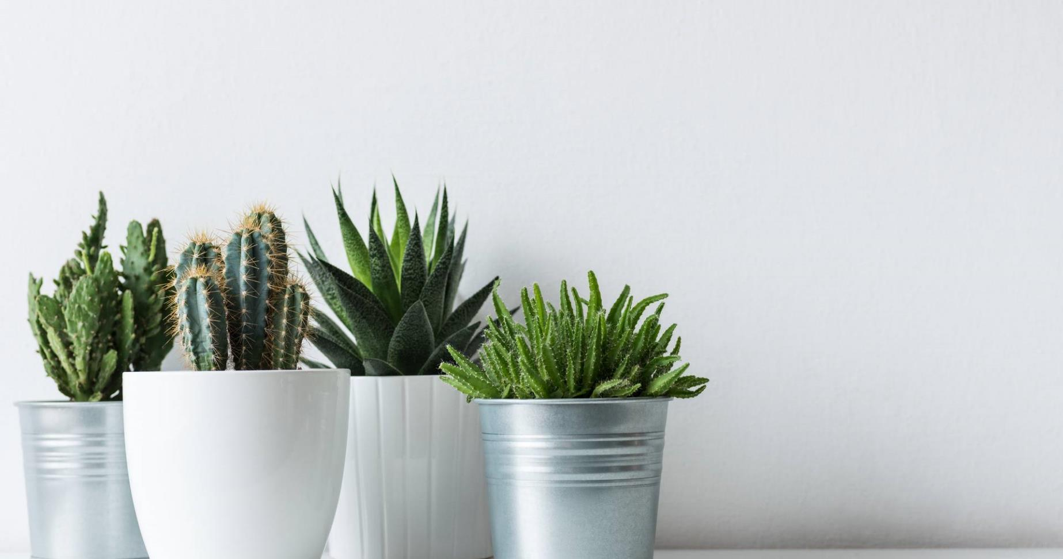
Replenish Spa Bistro
Lantana Spa

Slide 2
Replenish Bistro
Healthy Start
Banana Strawberry Smoothie $8 V
VANILLA YOGURT, APPLE & ORANGE JUICE
Peanut Butter & Banana Artisan Wheat Toast $8 V
LOCAL HONEY, GRANOLA
Smashed Avocado Artisan Wheat Toast $8 V
HARD BOILED EGG, SPROUTS
SMOKED SALMON $7
BACON $4
Tortilla Chips & Salsa $8 DF, V, GF
Guacamole $12
Southwest Hummus $14 DF, V, GF
FRESH VEGETABLES, TOASTED PITA, OLIVE OIL
Spicy Crab & Avocado $24 GF
ROASTED TOMATO, CUCUMBER PICO, TORTILLA CHIPS
Vegan Poke Bowl $15 DF, V
SESAME TOFU, SUSHI RICE, CUCUMBER, CRISPY
CHILI GARLIC, CARROT, AVOCADO, WAKAME, SCALLION, PINEAPPLE
SUB GRILLED CHICKEN $4
SUB CRAB $
Soup & Salads
Watermelon Gazpacho $9 DF, V, GF
TAJÍN, SORBET
Caprese Salad $14 V, GF
HEIRLOOM TOMATO, FRESH MOZZARELLA, BASIL PESTO
BALSAMIC
Grilled Chicken Caesar Salad $17
CRISPY CAPERS, PARMESAN AND CROUTONS
Mixed Green Salad $11 DF, V, GF
CUCUMBER, TOMATOES, CARROTS
CHOICE OF: RANCH, CAESAR, BALSAMIC,
LEMON AND OLIVE OIL
Sandwiches
CHOICE OF: FRESH CUT FRIES, SWEET POTATO FRIES
SIDE SALAD, FRESH CUT FRUIT, ASSORTED CHIPS
Turkey Club $16
TOMATO, BOURSIN RED PEPPER AIOLI
BACON, LETTUCE, TOASTED FOCACCIA
Smoked Salmon BLT $18
LEMON CAPER AIOLI, TOASTED WHEAT
Black Bean Veggie Burger $16 V
AVOCADO, LETTUCE, TOMATO, SWEET ONION
HUMMUS, SESAME SEED BUN
Spa Bistro Burger $18
AVOCADO, TOMATO JAM, LETTUCE, SWEET ONION
SESAME SEED BUN
S.W. Grilled Chicken $18
PEPPERJACK, PICO, LETTUCE,
BACON, CHIPOTLE RANCH, SESAME SEED BUN
Dessert
Strawberry Shortcake Trifle $9 V
WHIPPED CREAM, STRAWBERRY SAUCE
Oreo Chocolate Mousse Stack $9 V
CHOCOLATE CAKE, WHIPPED CREAM
Seasonal Sorbet $7 DF, V, GF
FRESH BERRIES
GF= Gluten Free V = Vegetarian DF= Dairy Free
The Department of Health states that consuming raw or undercooked seafood, meat or eggs may increase your risk of food-borne illness.
*An 18% Service Charge may be added to parties of 8 or more
Beverages
Seasonal Cold Pressed Juices $11
Grapes $16.5
12OZ WINE
ROSE, PINOT GRIS, PINOT NOIR, OR SPARKLING
6OZ SONOMA CUTRER CHARDONNAY $11
MIMOSA $11
Hard Seltzers
TRULY PINEAPPLE OR WILD BERRY $7.50
HIGH NOON GRAPEFRUIT OR WATERMELON $9
Beers
ULTRA, MODELO, DOS XX, MILLER, BUD LIGHT, COORS
FREETAIL HONEY BLONDE ALE, FREETAIL IPA
Cocktails
SANGRIA COCKTAIL $15
MOJITO $15
BLOODY MARY $15
MARGARITA $16
PINA COLADA ON THE ROCKS $14
MOSCOW MULE $14
WHISKEY SOUR $14
Jello Shots
BUZZY BITES JELLO SHOT FLAVORS $8
BUBBLY, ROSE, BLUE PUNCH, RED PUNCH LEMON DROP
Non-Alcoholic Beverages $4
ICE TEA, LEMONADE, PEPSI, DIET PEPSI, STARRY,
DR. PEPPER AND DIET PEPPER
Paloma Preserve $ 14
DESERT DOOR POLLINATOR, LIME JUICE, GRAPEFRUIT JUICE.
AGAVE, CLUB SODA

